Slide 1


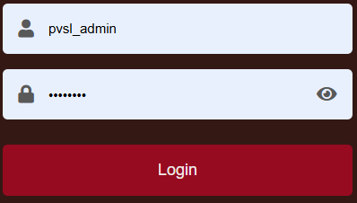
**Mobile View of Sign In Page. Please change the background of the Sign In window as per the white background

Slide 2

**Desktop View of Sign In Page. Please change the background of the Sign In window as per the white background

